Slide 1
SS8H1a
Native
Americans
Paleo, Archaic, Woodland,
& Mississippian
© 2014 Brain Wrinkles

Slide 2
Native American Cultures
10000 BC
8000 BC
1000 BC
800 AD
1600 AD
Archaic
Mississippian
Paleo
Woodland
© 2014 Brain Wrinkles

Slide 3
SS8H1a
Paleo
© 2014 Brain Wrinkles

Slide 4
Paleo Indians
The first group of people to inhabit Georgia were called Paleo Indians.
They lived in Georgia over 13,000 years ago, from 10000 to 8000 BC.
Paleo means “ancient” in Greek.
© 2014 Brain Wrinkles

Slide 5
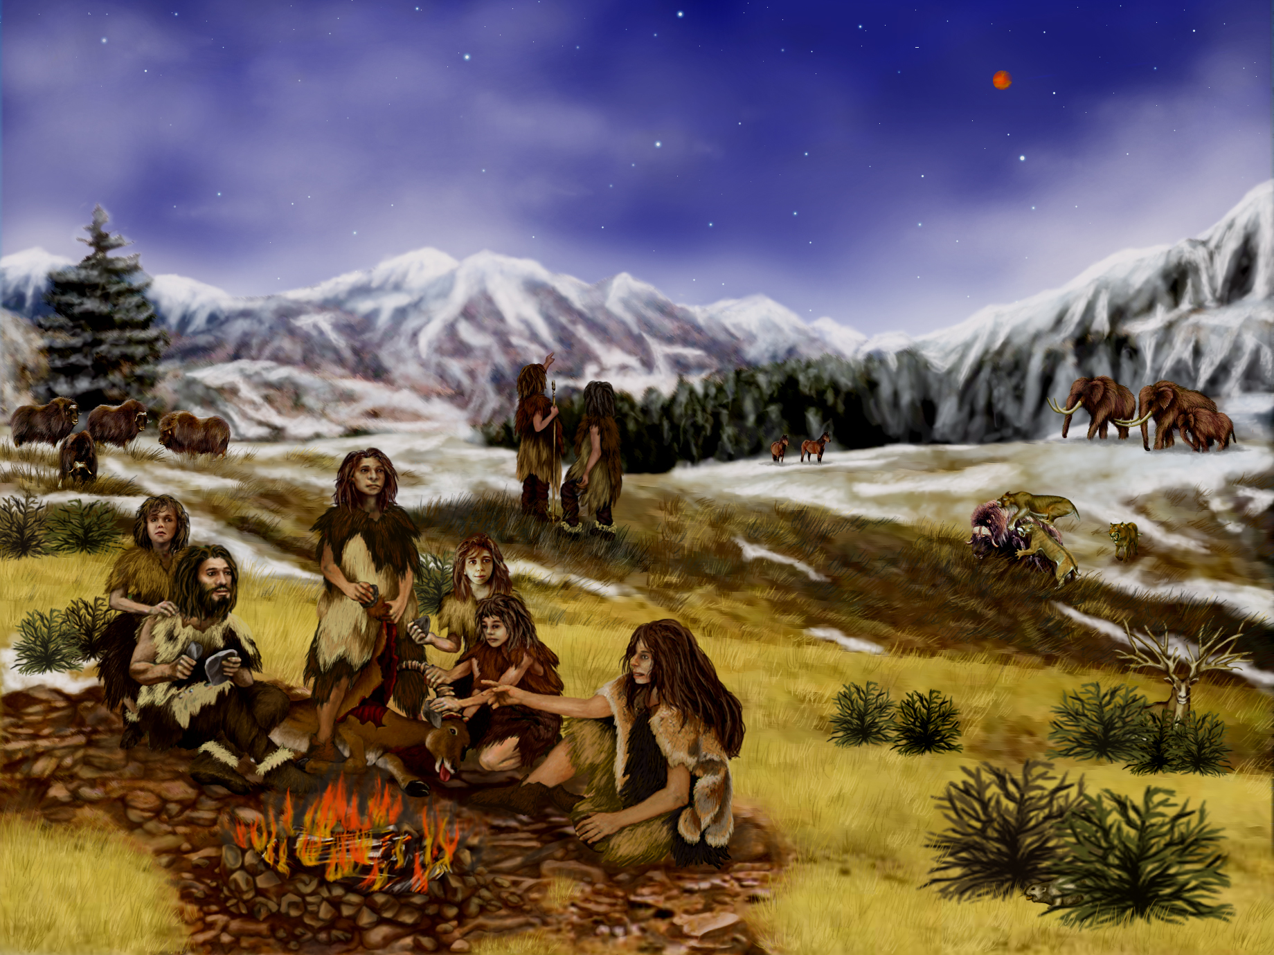
© 2014 Brain Wrinkles

Slide 6
Paleo Indians
Paleo Indians were nomadic, meaning that they moved around in search of food.
They moved from place to place in groups of 25-50.
They lived in nonpermanent dwellings made in pits or shelters covered with bark and animal hides.
© 2014 Brain Wrinkles

Slide 7
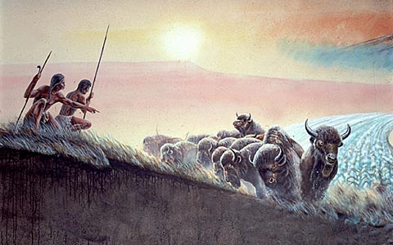
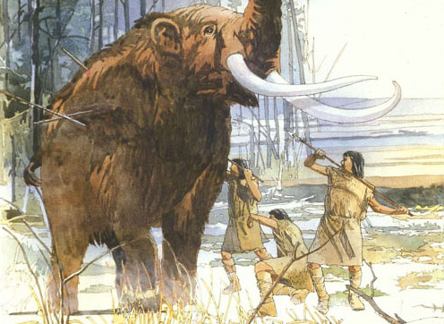
Paleo Indians
© 2014 Brain Wrinkles

Slide 8
SS8H1a
Archaic
© 2014 Brain Wrinkles

Slide 9
Archaic Indians
The Archaic Indians lived in Georgia beginning in 8000 BC until about 1000 BC.
They built the first permanent settlements, but were also nomadic as they moved each season in search of food.
The Archaic Indians created tools and weapons out of stone and bone.
© 2014 Brain Wrinkles

Slide 10
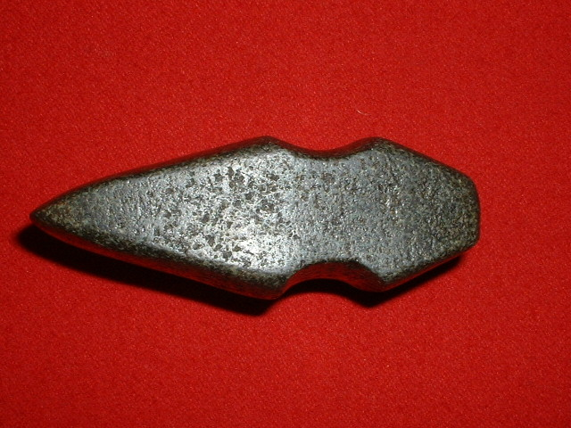
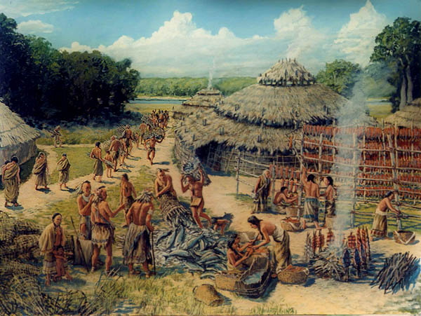
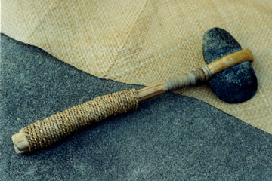
Archaic Indians
© 2014 Brain Wrinkles

Slide 11
Archaic Indians
The Archaic Indians were hunters, gatherers, and fishermen.
They hunted smaller animals like deer and rabbits.
They also ate nuts and shellfish.
© 2014 Brain Wrinkles

Slide 12
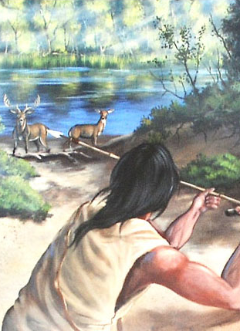
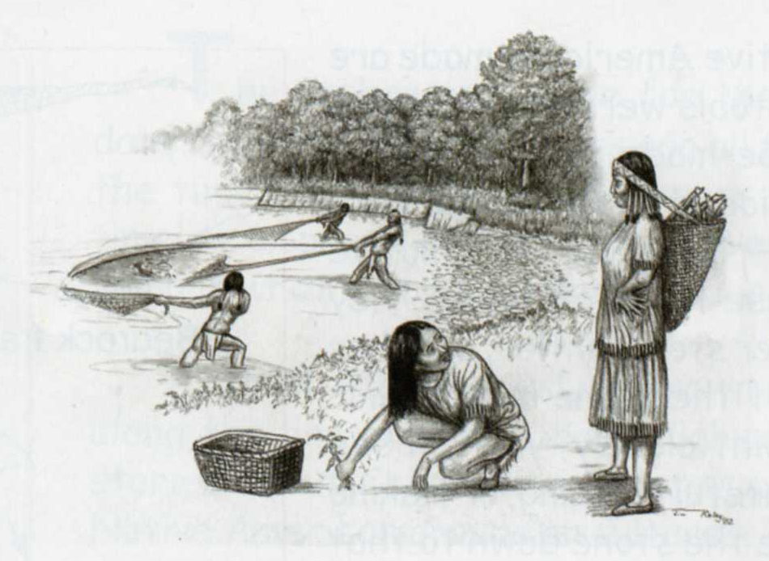
Archaic Indians
© 2014 Brain Wrinkles

Slide 13
SS8H1a
Woodland
© 2014 Brain Wrinkles

Slide 14
Woodland Indians
The Woodland Indians lived in Georgia from about 1000 BC to 1000 AD.
Their lifestyle differed from previous groups because they began to plant seeds for growing crops and they created decorative, long-lasting pottery.
They also developed bows and arrows for hunting.
© 2014 Brain Wrinkles

Slide 15
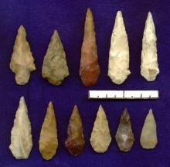
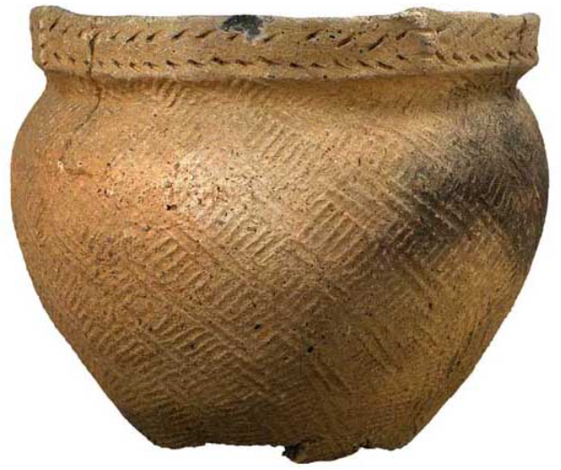
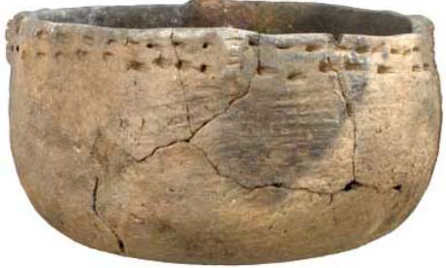
Woodland Indians
© 2014 Brain Wrinkles

Slide 16
Woodland Indians
The Woodland Indians formed tribes, created permanent villages, and lived in dome-shaped huts.
The Woodland Indians left the first evidence of religious beliefs.
They built mounds of earth for burial sites and religious ceremonies.
These were signs that the Woodland Indians believed in an afterlife.
© 2014 Brain Wrinkles

Slide 17
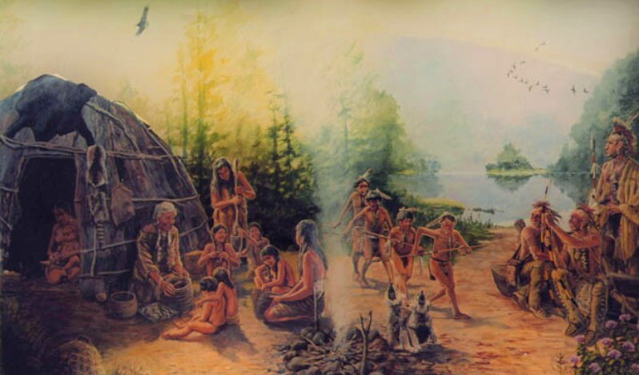
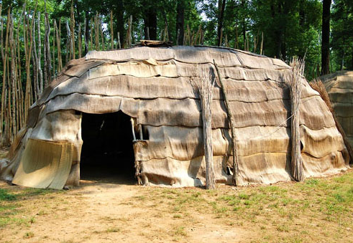
Woodland Indians
© 2014 Brain Wrinkles

Slide 18
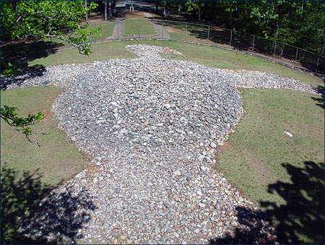
Rock Eagle is an Indian-made rock structure dating back to the Middle Woodland period (300 B.C. to A.D. 600).
© 2014 Brain Wrinkles

Slide 19
SS8H1a
Mississippian
© 2014 Brain Wrinkles

Slide 20
Mississippian Indians
The Mississippian Indians inhabited Georgia from about 800 to 1600 AD.
They lived in towns governed by chiefs, who lived in religious centers on top of large earthen mounds.
Mississippian settlements contained thousands of families.
Villages were protected by guard towers and moats.
© 2014 Brain Wrinkles

Slide 21
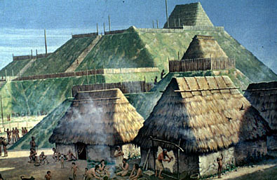
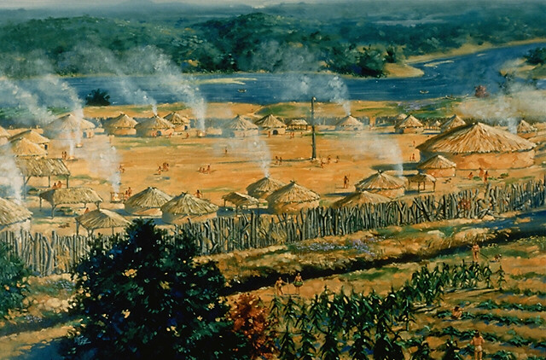
© 2014 Brain Wrinkles

Slide 22
Mississippian Indians
The Mississippian Indians used stone, wood, and bone to create weapons and farming tools.
They were accomplished craftsmen, creating pottery, pipes, instruments, and jewelry.
The Mississippian Indian groups traded tools, weapons, pottery, and other goods with one another.
© 2014 Brain Wrinkles

Slide 23
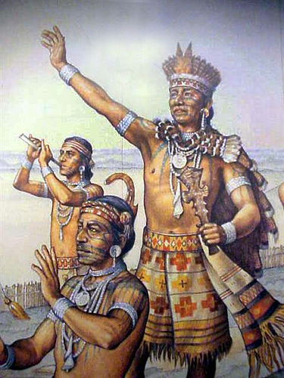
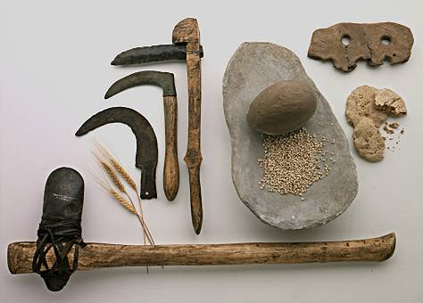
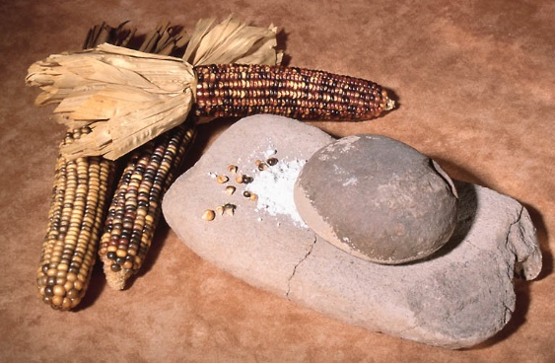
© 2014 Brain Wrinkles

Slide 24
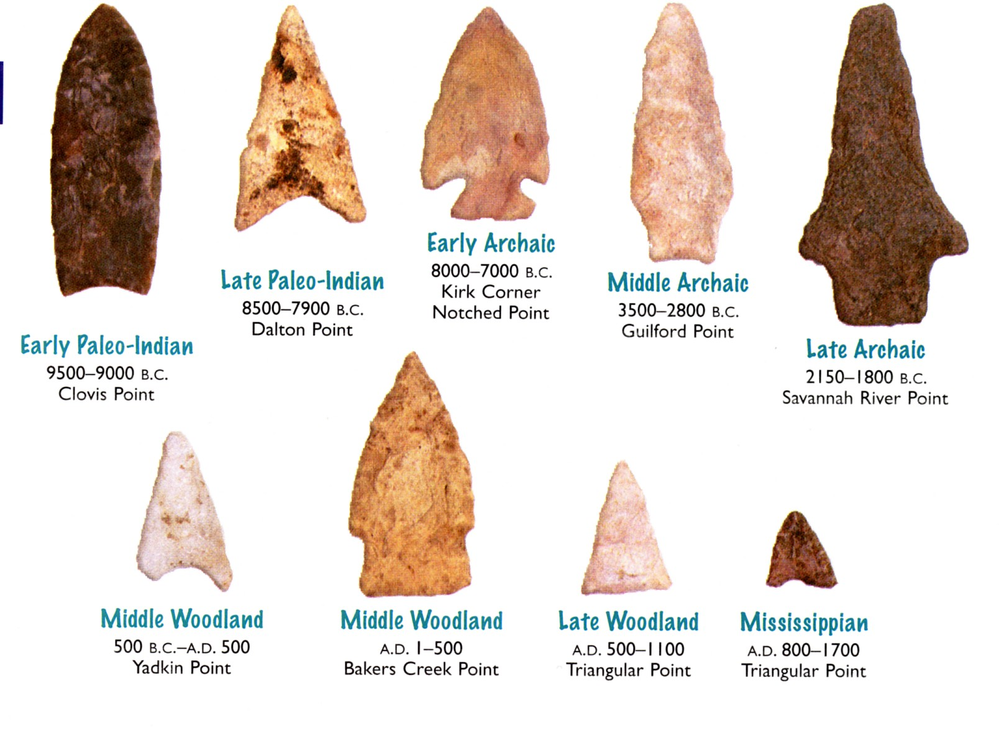
© 2014 Brain Wrinkles

Slide 25
Mississippian Indians
Mississippian Indians began farming on a large scale—they grew maize, squash, beans, tobacco, etc.
They built flat-topped burial mounds and had religious ceremonies.
The dead were buried in fine cloths with feathered headdresses and the bodies were tattooed and painted.
They were alive when Europeans discovered America, but soon after their culture began to disappear…
© 2014 Brain Wrinkles

Slide 26
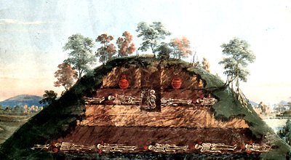
© 2014 Brain Wrinkles

